Slide 1

Reporting and Preparing Financial Statements
3
Chapter
UAA – ACCT 201 Principles of Financial Accounting Dr. Fred Barbee

Slide 2
IS FUN!
ACCOUNTING
ACCT 201 ACCT 201 ACCT 201

Slide 3
Chapter 3 - Day 2 - Agenda
Topic | LO | Read | HW
Closing Process | C4, C5 P4, P5 | 118-123 | QS8, QS9, E7
Classified Balance Sheet | C6 | 123-126 | E8, E9
Decision Analysis | A2, A3 | 126-127 | P2A

Slide 4
The
Closing
Process
ACCT 201 ACCT 201 ACCT 201
Notes:
Introduction and Review
We have covered a lot of ground in the last few class sessions. Your head is probably swimming with all of the new information we have been trying to stuff in.

Slide 5


Learning Objective
P4
  Describe and prepare closing entries.
Procedural

Slide 6
Learning Objective
C4
  Explain why temporary accounts are closed each period.
Conceptual

Slide 7
Temporary and Permanent Accounts
Revenues
Assets
Temporary Accounts
Expenses
Dividends
Permanent Accounts
Retained Earnings
Liabilities
Income Summary

Slide 8
Real (Permanent) Accounts
Account Title
Account No. ###
Date
Item
Post.
Ref.
Debit
Credit
Balance
Debit
Credit
ACCT 201 ACCT 201 ACCT 201
vs.
Account Title
Account No. ###
Date
Item
Post.
Ref.
Debit
Credit
Balance
Nominal (Temporary) Accounts
Debit
Credit

Slide 9
Real Accounts
Account Title |  |  |  |  | Account No. ###
Date |  | Item | Post. Ref. | Debit | Credit | Balance
 |  |  |  |  |  | Debit | Credit

Slide 10

Real Accounts . . .
Accounts that are not closed to a zero balance at the end of each accounting period.
Permanent accounts appearing on the Balance Sheet.

Slide 11

Assets
Assets
Liabilities
Liabilities
ACCT 201 ACCT 201 ACCT 201
Owner’s Equity
Owner’s Equity
2001
2002

Slide 12
Nominal Accounts
Account Title |  |  |  |  | Account No. ###
Date |  | Item | Post. Ref. | Debit | Credit | Balance
 |  |  |  |  |  | Debit | Credit

Slide 13
Nominal Accounts . . .
Accounts that are closed to a zero balance at the end of each accounting period.
Temporary accounts generally appearing on the Income Statement.

Slide 14
Revenues
Revenues
$
-0-
Expenses
Expenses
ACCT 201 ACCT 201 ACCT 201
$
-0-
2001
2002

Slide 15

What are closing entries?
ACCT 201 ACCT 201 ACCT 201

Slide 16

Closing Entries . . .
Journal entries made at the end of an accounting period.
  They clear all nominal accounts and prepare them to receive transactions in the new accounting period.
  They summarize a period’s revenues and expenses.

Slide 17
Purpose of Closing Entries
Closing entries bring the income statement accounts back to a zero balance, making them ready for a new set of transactions.

Slide 18
Purpose of Closing Entries .
The closing entry process transfers the net income or net loss for the accounting period to the owner’s equity and
Reduces owner’s equity for any distributions to owners.

Slide 19
Is there a set procedure?
ACCT 201 ACCT 201 ACCT 201

Slide 20





Steps in the
Closing
Process
Notes:
Step 1: Analyze Transactions
The first step in the accounting cycle is to analyze transactions and the business documents.
The business or “source” documents are used as the basis for recording accounting entries.

Slide 21
Introducing a new account!
Account Title |  |  |  |  | Account No. ###
Date |  | Item | Post. Ref. | Debit | Credit | Balance
 |  |  |  |  |  | Debit | Credit
Income Summary
Notes:
The T-Account
The simplest, most fundamental format of an account is in the configuration of the letter T, and is called a T-Account.
A T-account is a simplified depiction of an account in the form of a letter T, showing increases on one side of the account and decreases on the other side of the vertical line of the T.

Slide 22
Step One
Close the
revenue
Accounts
Notes:
Step 1: Analyze Transactions
The first step in the accounting cycle is to analyze transactions and the business documents.
The business or “source” documents are used as the basis for recording accounting entries.

Slide 23
Step Two
Close the
Expense
Accounts
Notes:
Step 1: Analyze Transactions
The first step in the accounting cycle is to analyze transactions and the business documents.
The business or “source” documents are used as the basis for recording accounting entries.

Slide 24
Step Three
Close the
Income
Summary
Account
Notes:
Step 1: Analyze Transactions
The first step in the accounting cycle is to analyze transactions and the business documents.
The business or “source” documents are used as the basis for recording accounting entries.

Slide 25
Step Four
Close the
Dividend
Account
Notes:
Step 1: Analyze Transactions
The first step in the accounting cycle is to analyze transactions and the business documents.
The business or “source” documents are used as the basis for recording accounting entries.

Slide 26
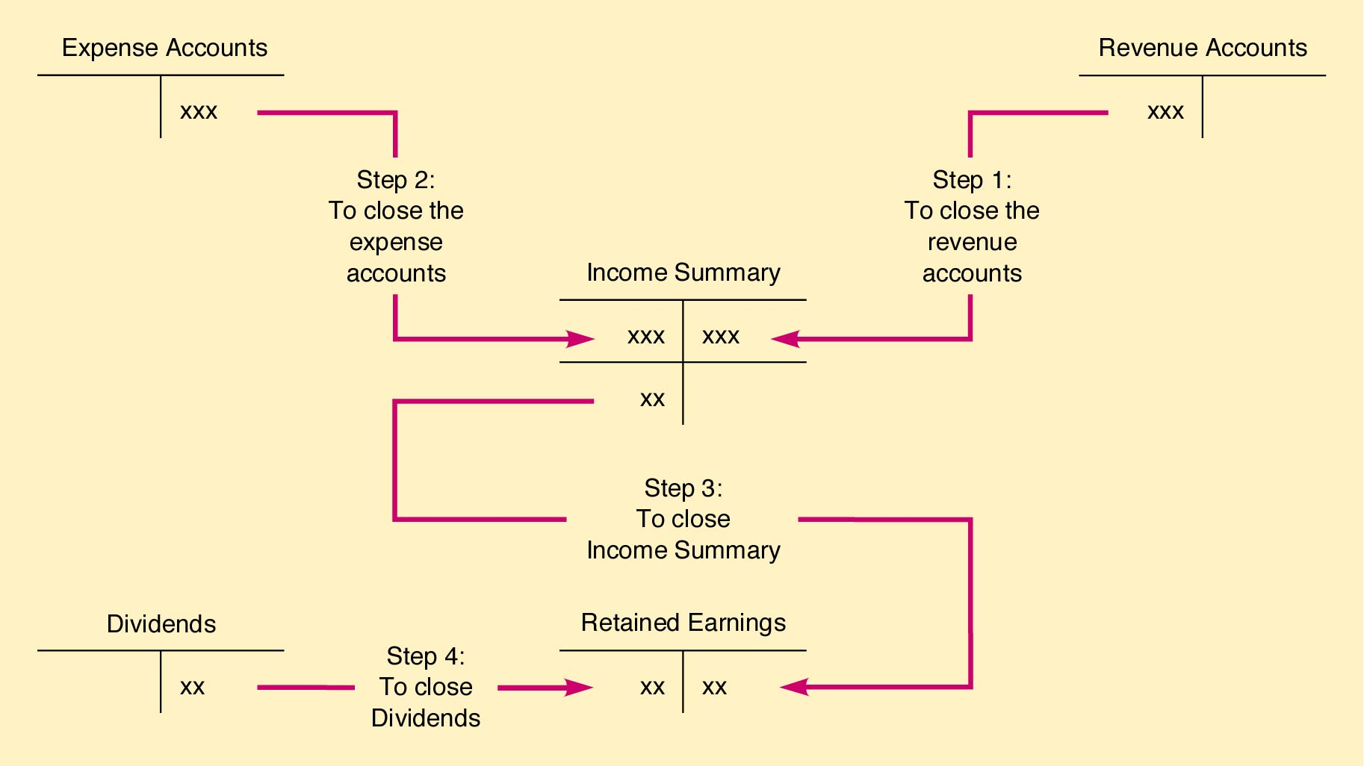
Overview of the Closing Process

Slide 27
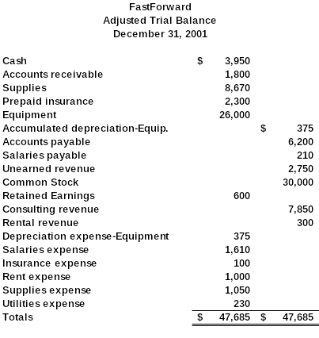
Using the adjusted trial balance, let’s prepare the closing entries for FastForward.

Slide 28
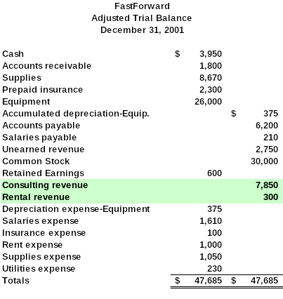
Step #1:
Close
Revenue
Accounts
to Income
Summary

Slide 29
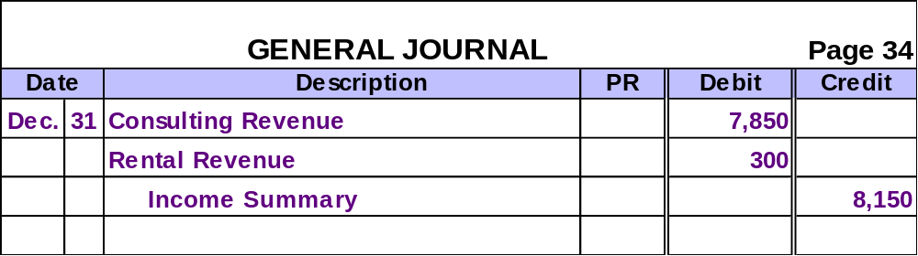
Close Revenue Accounts to Income Summary
Now, let’s look at the ledger accounts after posting this closing entry.

Slide 30
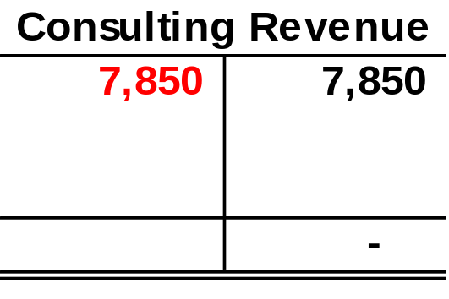
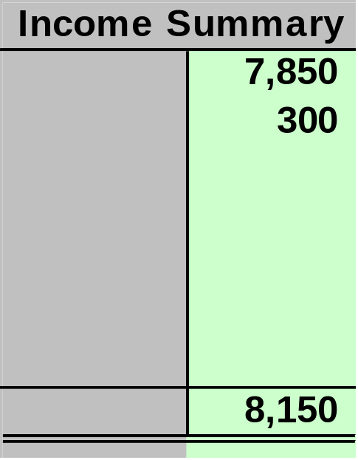
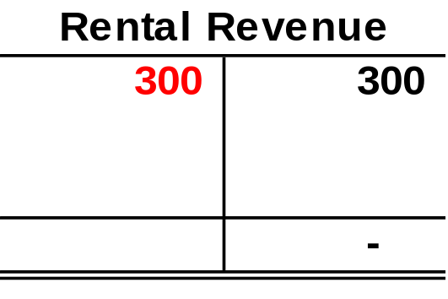
Close Revenue Accounts to Income Summary

Slide 31
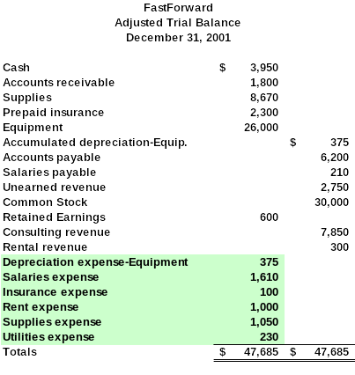
Step #2:
Close
Expense
Accounts
to Income
Summary

Slide 32
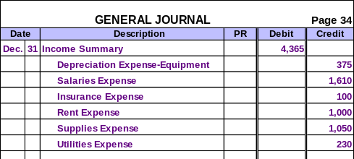
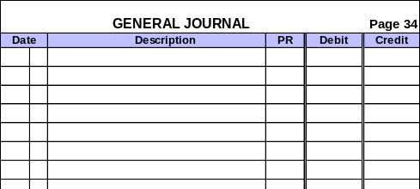
Close Expense Accounts to Income Summary
Now, let’s look at the ledger accounts after posting this closing entry.

Slide 33
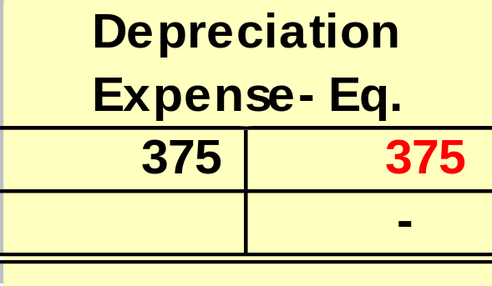
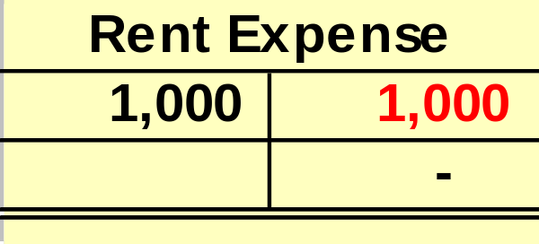
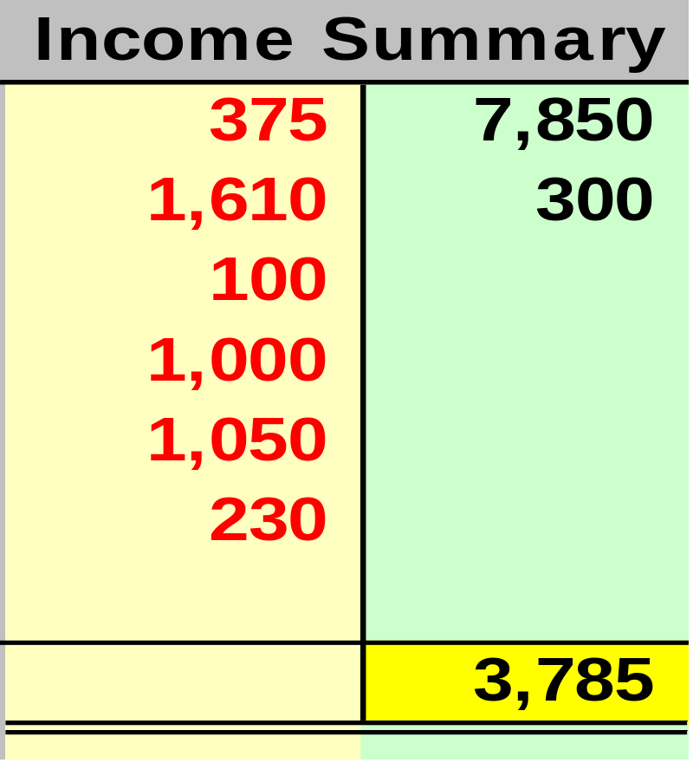
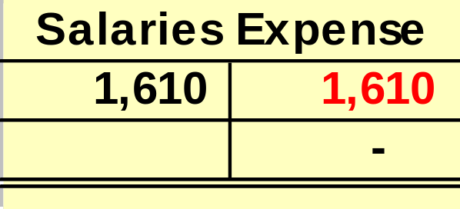
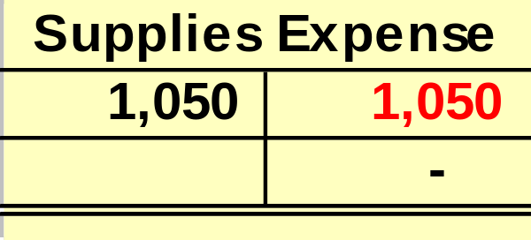
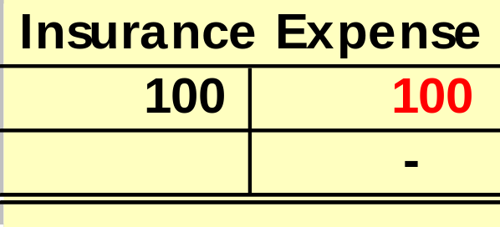
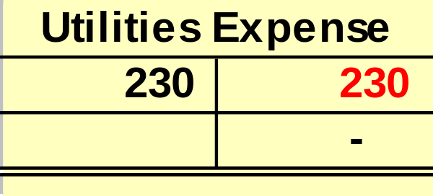
Close Expense Accounts to Income Summary
Net Income

Slide 34
Step #3:
Close
Income
Summary
to Retained
Earnings

Slide 35
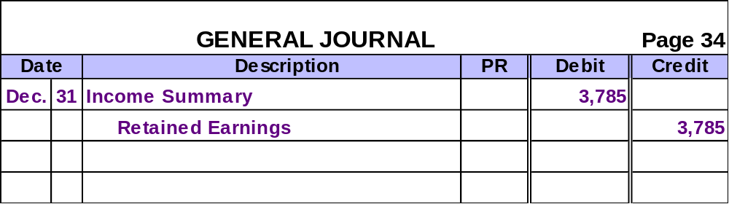
Close Income Summary to Retained Earnings
Now, let’s look at the ledger accounts after posting this closing entry.

Slide 36
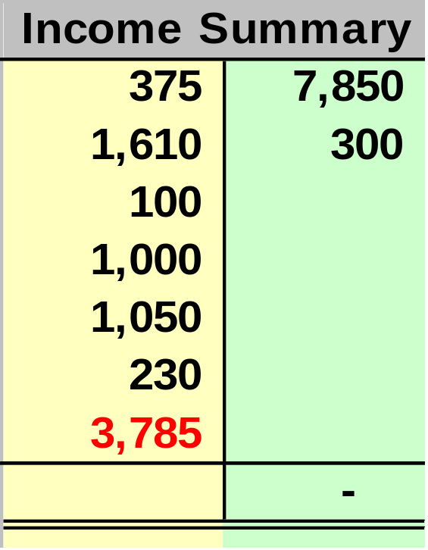
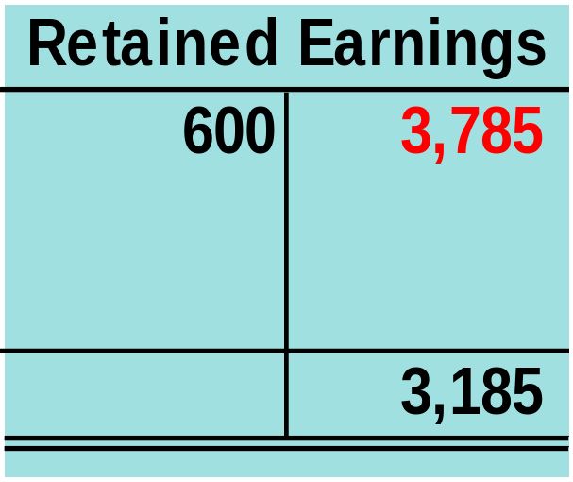
Close Income Summary to Retained Earnings

Slide 37
Learning Objective
P5
  Explain and prepare a post-closing trial balance.
Procedural

Slide 38
Post-Closing Trial Balance
List of permanent accounts and their balances after posting closing entries.
Total debits and credits must be equal.

Slide 39
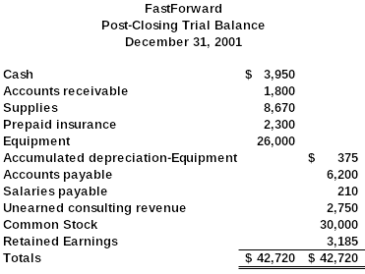
ACCT 201 ACCT 201 ACCT 201

Slide 40
Review the
Accounting
Cycle
ACCT 201 ACCT 201 ACCT 201
Notes:
Introduction and Review
We have covered a lot of ground in the last few class sessions. Your head is probably swimming with all of the new information we have been trying to stuff in.

Slide 41
Learning Objective
C5
  Identify steps in the accounting cycle.
Conceptual

Slide 42

The Accounting Cycle
1. Analyze Transactions
10. Reverse (Optional)
9. Prepare Post-Closing Trial balance
2. Journalize
8. Close
3. Post
7. Prepare Statements
4. Prepare Unadjusted Trial Balance
5. Adjust
6. Prepare Adjusted Trial Balance

Slide 43
Classified
Balance
Sheet
ACCT 201 ACCT 201 ACCT 201
Notes:
Introduction and Review
We have covered a lot of ground in the last few class sessions. Your head is probably swimming with all of the new information we have been trying to stuff in.

Slide 44
Learning Objective
C6
  Explain and prepare a classified balance sheet.
Conceptual

Slide 45
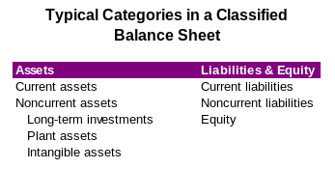
Classified Balance Sheet

Slide 46
Current Assets/Liabilities
Current items are those expected to come due (either collected or owed) within one year or the company’s operating cycle, whichever is longer.

Slide 47
Operating Cycle – Service Company – Exhibit 3-31
Cash
Available
Customers pay for services
Cash paid for employee work
Services sold to customers

Slide 48
Operating Cycle – Merchandising Company
Cash
Available
Customers pay for products
Cash paid for products
Products sold to customers

Slide 49

Classified Balance Sheet
Let’s look at the asset section of a classified balance sheet.
ACCT 201 ACCT 201 ACCT 201

Slide 50
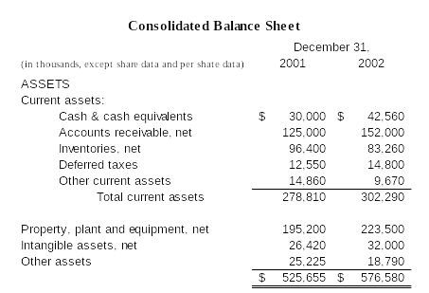

Slide 51
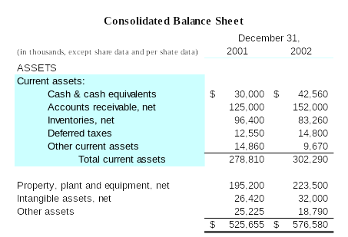
Current assets are assets that will be turned into cash or expire (be used up) within the longer of one year or the operating cycle.

Slide 52
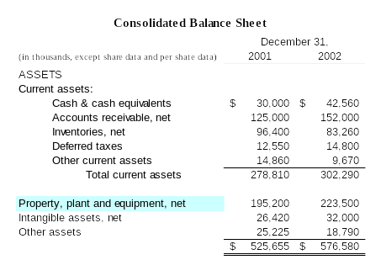
Property, plant and equipment includes assets with useful lives of more than one year acquired for use in the business rather than for resale.

Slide 53
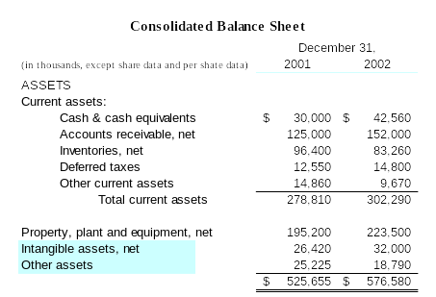
Other assets and intangible assets include items such as patents, goodwill, copyrights, etc.

Slide 54
Classified Balance Sheet
Let’s look at the liability section of a classified balance sheet.
ACCT 201 ACCT 201 ACCT 201

Slide 55
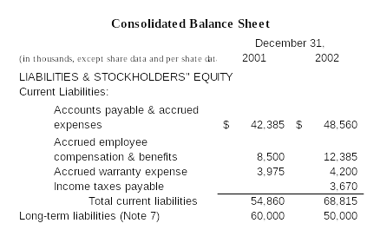

Slide 56
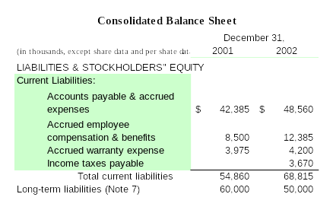
Current liabilities are obligations that will be paid with current assets, normally within one year.

Slide 57
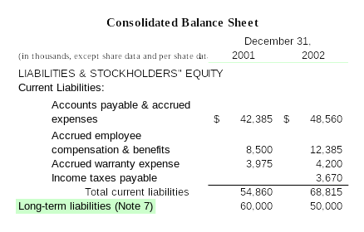
Long-term liabilities are debts that have maturity dates extending beyond one year from the balance sheet date.

Slide 58
Let’s look at the stockholders’ equity section of a classified balance sheet.
ACCT 201 ACCT 201 ACCT 201

Slide 59
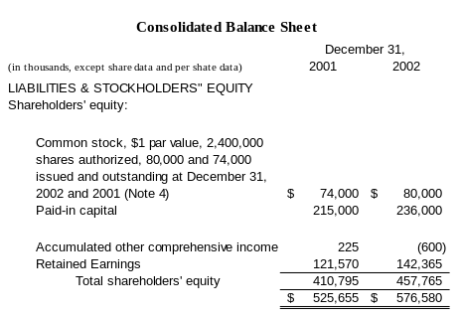

Slide 60
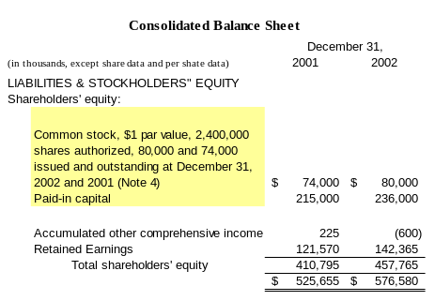
Contributed capital is often shown in two separate accounts . . .
Common stock
Paid-in capital

Slide 61
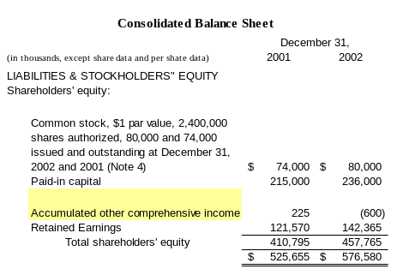
Comprehensive income includes gains and losses not included in the computation of net income.

Slide 62
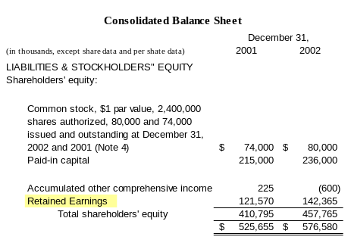
Retained earnings is the accumulated earnings of the company less the accumulated dividends declared.

